Slide 1
COMPUTER ORGANIZATION AND ARCHITECTURE
Dr. Rizwan Khan
Head – Department of Computer Science and Engineering
(An NBA Accredited Program)
ABES Institute of Technology, Ghaziabad

Slide 2
Counting Based Page Replacement
Least Frequently used (LFU) page-replacement algorithm
Most frequently used (MFU) page-replacement algorithm
When there is a tie, use FIFO

Slide 3
Least Frequently used (LFU)
REF. String | 7 | 0 | 1 | 2 | 0 | 3 | 0 | 4 | 2 | 3 | 0
 | 7 | 7 | 7 | 2 | 2 | 2 | 2 | 4 | 4 | 3 | 3
 |  | 0 | 0 | 0 | 0 | 0 | 0 | 0 | 0 | 0 | 0
 |  |  | 1 | 1 | 1 | 3 | 3 | 3 | 2 | 2 | 2
Count
0 |  | 1 | 1 | 1 | 2 | 2 | 3 | 3 | 3 | 3 | 4
1 |  |  | 1 | 1 | 1 | 1 | 1 | 1 | 1 | 1 | 1
2 |  |  |  | 1 | 1 | 1 | 1 | 1 | 2 | 2 | 2
3 |  |  |  |  |  | 1 | 1 | 1 | 1 | 2 | 2
4 |  |  |  |  |  |  |  | 1 | 1 | 1 | 1
7 | 1 | 1 | 1 | 1 | 1 | 1 | 1 | 1 | 1 | 1 | 1

Slide 4
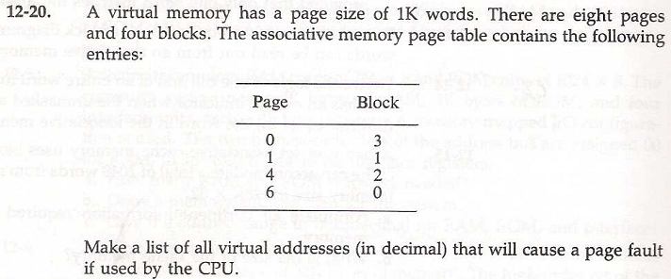
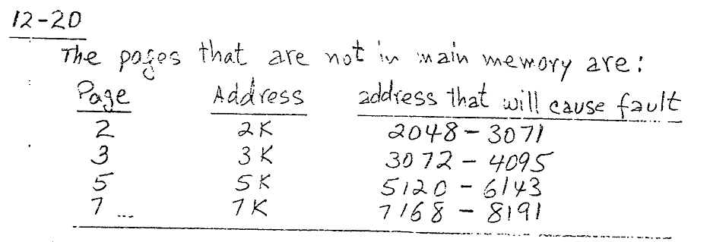
12-20

Slide 5
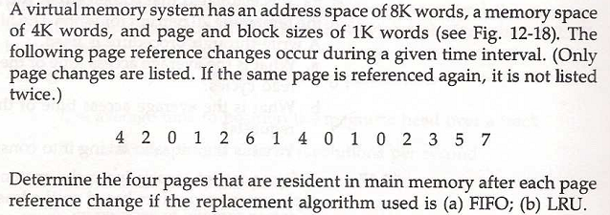
12-21

Slide 6
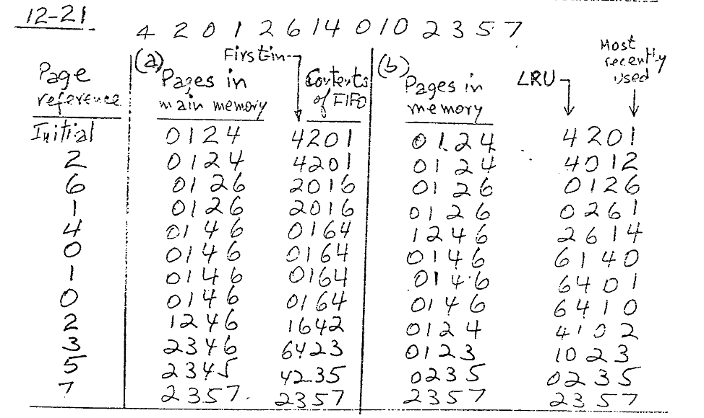
12-21 Solution

Slide 7


